Slide 1
Standards for Teaching Social Studies
ESE 549 / 749
Eastern Kentucky University

Slide 2
REVIEW

Slide 3
Review – 1st & 2nd class meeting
Kentucky Core Content for Social Studies Assessment
Quiz
Core Content for Social Studies Assessment 4.1 belongs to a larger Kentucky curriculum document called:
The Core Content for Social Studies Assessment are used for the following:
What are the 5 subdomains of the Social Studies Core Content for Assessment?
What is the purpose of the supporting content standards?
The examples included in parentheses are the ONLY examples that can be included in the state assessment.
Depth of Knowledge (DOK) is:
What DOK levels do NOT appear in the High School Core Content for Assessment?
Notes:
1. Kentucky's Program of Studies for Grades Primary - 12
2. provide the material for test developers to create the state assessment (CATS) test items
3. Government & Civics, Cultures & Societies, Economics, Geography, Historical Perspective
4. It is critical to the student’s deep understanding of the overall content and is to be used by schools to build a foundation of knowledge, skills, and processes that will enable students to be successful on the Kentucky Core Content Test. These standards are proposed for local instruction and assessment and appear in italics in the Core Content document.
5. False
6. the depth of knowledge and cognitive complexity for the content standard that is appropriate for each grade level for the state assessment.
7. 1 & 4

Slide 4
Review – 2nd class meeting
Standards
Comparing and contrasting
ACT U.S. History end-of-course assessment standards
AND
KY Core Content Standards for Social Studies
Creating Essential Questions
Writing ACT-style essential questions
Writing Grant Wiggins-style essential questions

Slide 5
Review – 3rd Class meeting
Teaching Social Studies Skills
Analyzing
Social Studies Skills KY Core Content for Social Studies
AND
Social Studies Skills in ACT U.S. History end-of-course assessment
Teaching Analyzes of visual primary sources
History Alive/TCI Visual Discovery Lecture
Assignment – Create a Visual Discovery Lecture

Slide 6
KY Core Content - High School Social Studies SKILLS
The Use of Geographic Tools
SS-HS-4.1.1 Students will use a variety of geographic tools (e.g., maps, globes, photographs, models, satellite images, charts, graphs, databases) to explain and analyze the reasons for the distribution of physical and human features on Earth's surface. DOK 3
SS-HS-4.1.2 Students will explain how mental maps, the mental image a person has of an area including knowledge of features and spatial relationships, become more complex as experience, study and the media bring new geographic information.
SS-HS-4.1.3 Students will use geographic tools (e.g., maps, globes, photographs, models, satellite images) to interpret the reasoning patterns (e.g., available transportation, location of resources and markets, individual preference, centralization versus dispersion) on which the location and distribution of Earth's human features is based.
The Factual and Interpretive Nature of History
SS-HS-5.1.1 Students will use a variety of tools (e.g., primary and secondary sources, data, artifacts) to analyze perceptions and perspectives (e.g., gender, race, region, ethnic group, nationality, age, economic status, religion, politics, geographic factors) of people and historical events in the modern world (1500 A.D. to present) and United States History (Reconstruction to present). DOK 3
SS-HS-5.1.2 Students will analyze how history is a series of connected events shaped by multiple cause and effect relationships, tying past to present. DOK 3

Slide 7
ACT Course Standards—U.S. History
ACT Course Standards—U.S. History A. Exploring the Skills and Strategies Underlying U.S. History
1. Process Skills
a. | Apply terms relevant to the content appropriately and accurately
b. | Identify and interpret different types of primary and secondary sources of fundamental importance and relevance to topical inquiry and understanding
c. | Interpret timelines of key historical events, people, and periods; locate significant historical places and events on maps
d. | Analyze the importance of context and point of view in historical interpretation (e.g., interpret past events and issues in historical context rather than in terms of present norms and values); recognize that historians interpret the same events differently due to personal values and societal norms
e. | Analyze and evaluate historical sources and interpretations (e.g., credibility, perspective, bias, and authenticity; verifiable or unverifiable; fact or interpretation)
f. | Utilize research strategies, methods, and sources to obtain, organize, and interpret historical data
g. | Compose arguments/position papers, and participate in debates on different interpretations of the same historical events; synthesize primary and secondary sources to justify position
h. | Compose an analytical, historical essay containing a thesis, supporting evidence, and a conclusion

Slide 8
The Standards Movement
New Topic

Slide 9
The wonderful thing about standards is that there are so many of them to choose from.”
Grace Hopper (computer scientist)

Slide 10
Defining the concept: Standard
Definitions????????

Slide 11
noun
1. something considered by an authority or by general consent as a basis of comparison; an approved model.
2. an object that is regarded as the usual or most common size or form of its kind: We stock the deluxe models as well as the standards.
3. a rule or principle that is used as a basis for judgment: They tried to establish standards for a new philosophical approach.
4. an average or normal requirement, quality, quantity, level, grade, etc.: His work this week hasn't been up to his usual standard.
5. standards, those morals, ethics, habits, etc., established by authority, custom, or an individual as acceptable: He tried to live up to his father's standards.
EXPAND 6. a grade of beef immediately below good.
7. the authorized exemplar of a unit of weight or measure.
8. a certain commodity in or by which a basic monetary unit is stated. Compare gold standard, silver standard, bimetallism, monometallism.
9. the legally established content of full-weight coins.
10. the prescribed degree of fineness for gold or silver.
11. British . a class or grade in elementary schools.
12. a musical piece of sufficiently enduring popularity to be made part of a permanent repertoire, especially a popular song.
13. a flag indicating the presence of a sovereign or public official.
14. a flag, emblematic figure, or other object raised on a pole to indicate the rallying point of an army, fleet, etc.
15. Military . a. any of various military or naval flags.
b. the colors of a mounted unit.
c. ( initial capital letter ) a U.S. Navy radar-guided surface-to-air missile with a range of 10–30 miles (16–48 km).
16. Heraldry . a long, tapering flag or ensign, as of a monarch or a nation.
17. something that stands or is placed upright.
18. a long candlestick or candelabrum used in a church.
19. an upright support or supporting part.
20. Armor . a standing collar of mail.
21. Horticulture . a plant trained or grafted to have a single, erect, treelike stem.
22. Botany . a distinct petal, larger than the rest, of certain flowers; a vexillum.

Slide 12
Preview Activity:
List all of the sets of standards that you can remember . . . .
Local?
State?
National?

Slide 13
Local Standards
Curriculum Guides
Textbooks
Texas and California are very influential in setting textbooks standards. . . .Why?

Slide 14
State Standards
Kentucky's Program of Studies for Grades Primary – 12
the minimum required content standards students shall be taught to meet the high school graduation requirements
http://www.education.ky.gov/KDE/Instructional+Resources/Curriculum+Documents+and+Resources/Program+of+Studies
Kentucky's Learning Goals and Academic Expectations
Assumptions underlying KERA (1990)
“All students are capable of learning”
6 – 7 learning goals – developed into 59 academic expectations
http://www.education.ky.gov/KDE/Instructional+Resources/Curriculum+Documents+and+Resources/Academic+Expectations/
Core Content for Assessment
represents the content that has been identified as essential for all students to know and will be included on the state assessment.
http://www.education.ky.gov/KDE/Instructional+Resources/Curriculum+Documents+and+Resources/Core+Content+for+Assessment/
Kentucky Teacher Standards
EPSB Code of Conduct
Newest addition???????

Slide 15
National Standards
National Council for the Social Studies (NCSS)
National Curriculum Standards for Social Studies: A Framework for Teaching, Learning, and Assessment
Culture: Traditions, beliefs, and values of their own groups and society, as well as those of others
Time, Continuity, and Change: The past, as well as stability and change over time
People, Places, and Environments: Spatial concepts and relationships
Individual Development and Identity: Personal identity and cultural contexts
Individuals, Groups, and Institutions: Types of groups and institutions and their relationships to individuals
Power, Authority, and Governance: Structure of specific governments and various types of government across time and cultures
Production, Distribution, and Consumption: Decisions that peoples and governments make when limited resources exceed wants
Science, Technology, and Society: Influence of science and technology over time on the lives of individuals and societies
Global Connections: The increasing links of peoples and societies across the world in terms of economy, communication, technology, and other factors
Civic Ideals and Practices: Ideals, beliefs, values, and practices associated with informed citizenship

Slide 16
More National Standards
National Center for History & the National Council for History Standards
National Standards for History Basic Edition, (1996)
http://www.nchs.ucla.edu/Standards/
U.S. National Geography Standards (1994)
http://www.nationalgeographic.com/xpeditions/standards/matrix.html
National Standards for Civics and Government
http://www.civiced.org/index.php?page=stds
Council for Economic Education
National Content Standards in Economics (2010)
http://www.councilforeconed.org/ea/program.php?pid=19
National Standards for High School Psychology (2010)
http://www.apa.org/education/k12/national-standards.aspx
Education Technology Standards
http://www.iste.org/standards.aspx
COMING SOON . . . . . . .
National Common Core Social Studies Standards

Slide 17
History of Standards
A Nation at Risk
1983 - report commissioned by federal Secretary of Education (who was the president?)
Started the standards movement in the U. S.
Said American schools were failing
"the educational foundations of our society are presently being eroded by a rising tide of mediocrity that threatens our very future as a Nation and a people"
"If an unfriendly foreign power had attempted to impose on America the mediocre educational performance that exists today, we might well have viewed it as an act of war
2000 - federal Elementary and Secondary Education Act (ESEA) re-authorized to address standards
re-christened the No Child Left Behind (NCLB) Act.

Slide 18
Types of standards:
Academic standards describe what students should know and be able to do in the core academic subjects at each grade level.
Content standards describe basic agreement about the body of education knowledge that all students should know.
Performance standards describe what level of performance is good enough for students to be described as advanced, proficient, below basic, or by some other performance level.
World-class standards – content and performances that are expected of students in other industrialized nations
Opportunity-to-learn standards – conditions and resources necessary to give all students an equal chance to meet performance standards

Slide 19
Reading & Writing Skills in Social Studies: Common Core Standards
New Topic

Slide 20
Common Core State Standards
Kentucky’s Literacy Standards for Social Studies

Slide 21
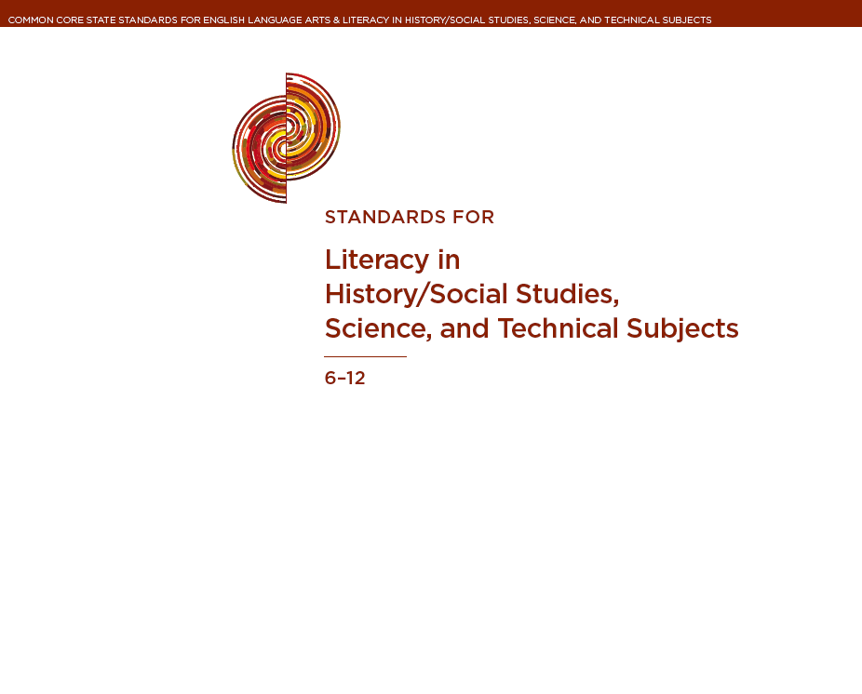
http://www.corestandards.org/assets/CCSSI_ELA%20Standards.pdf
P. 59

Slide 22
Do teachers usually assign tasks to practice skills?
example – “read this article and write a paper”
OR
Do teachers teach students the skills they need to do the task?
example – “let’s practice each step involved in analyzing an article”

Slide 23
Same question in another context
What if the PE teacher told students “play basketball” but none of the students knew the rules?
What in the music teacher said “play this song” but none of the students knew how to read music?

Slide 24
Reading

Slide 25
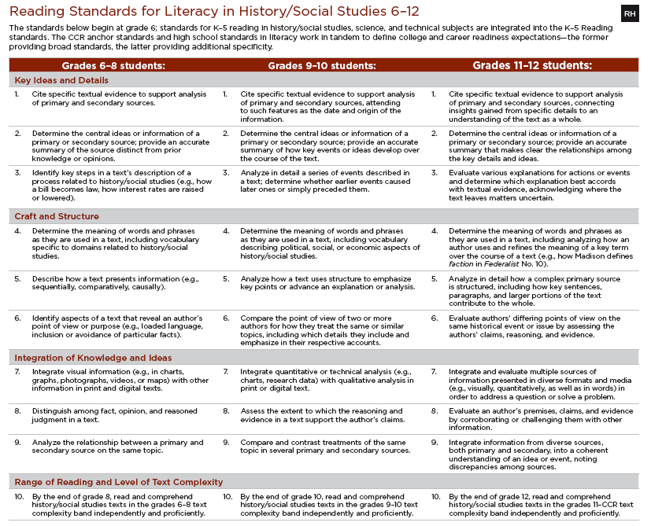

Slide 26
Reading - Skills
Can you read?
Yes! Reading is a SKILL
Can you explain the SKILLS you use to read?
Can you teach the SKILLS students need to read well?

Slide 27
ACTIVITY:
With your partner – discuss each Reading Standards for Literacy in History/Social Studies (grade 11-12).
Discuss when/where/how you learned this skill.
Brainstorm a lesson/activity that you might use in a high school classroom to teach this skill(s).

Slide 28
Writing

Slide 29
Writing - Skills
Can you write / compose papers?
Can you research a topic?
Yes! Writing / research is a SKILL
Can you explain the SKILLS you use to write?
Can you teach the SKILLS students need to write well?

Slide 30
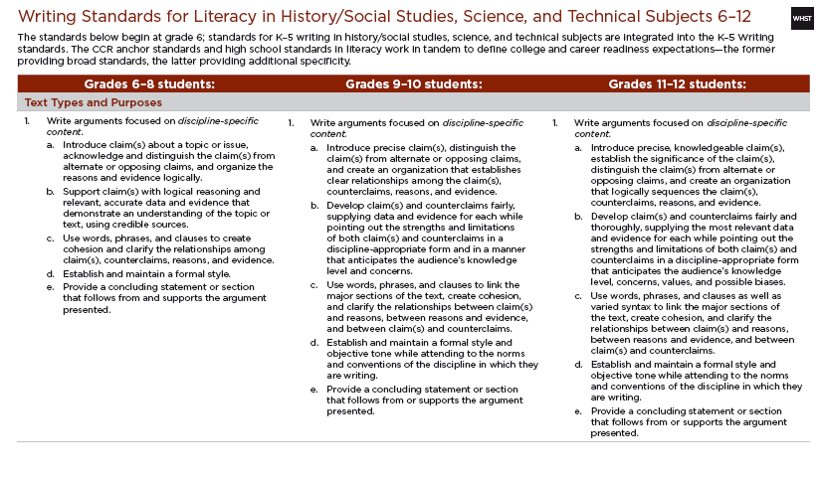

Slide 31
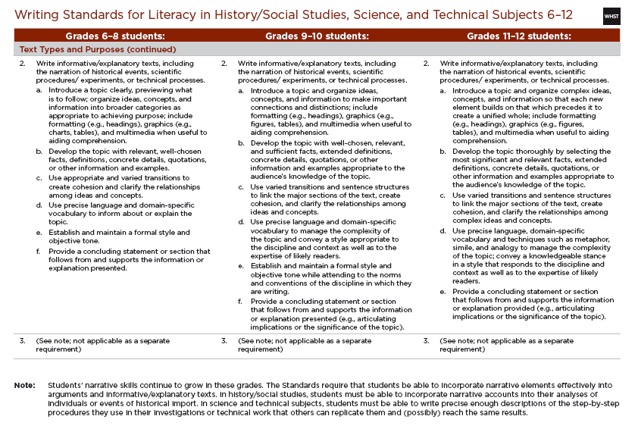

Slide 32
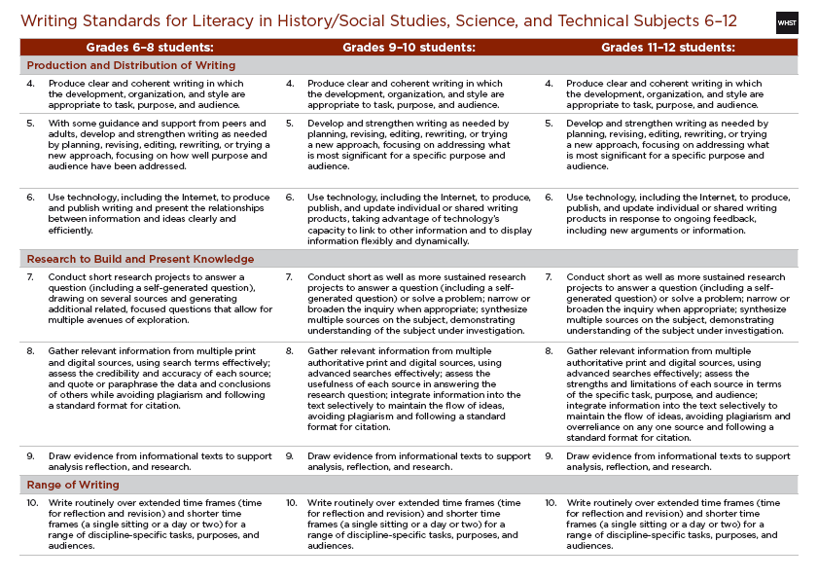

Slide 33
ACTIVITY: Compare the ACT Skills TO Reading /Writing Standards for Literacy in History/Social Studies
ACT Course Standards—U.S. History A. Exploring the Skills and Strategies Underlying U.S. History
ACT Process Skills
a. | Apply terms relevant to the content appropriately and accurately
b. | Identify and interpret different types of primary and secondary sources of fundamental importance and relevance to topical inquiry and understanding
c. | Interpret timelines of key historical events, people, and periods; locate significant historical places and events on maps
d. | Analyze the importance of context and point of view in historical interpretation (e.g., interpret past events and issues in historical context rather than in terms of present norms and values); recognize that historians interpret the same events differently due to personal values and societal norms
e. | Analyze and evaluate historical sources and interpretations (e.g., credibility, perspective, bias, and authenticity; verifiable or unverifiable; fact or interpretation)
f. | Utilize research strategies, methods, and sources to obtain, organize, and interpret historical data
g. | Compose arguments/position papers, and participate in debates on different interpretations of the same historical events; synthesize primary and secondary sources to justify position
h. | Compose an analytical, historical essay containing a thesis, supporting evidence, and a conclusion

Slide 34
ACTIVITY: Compare the ACT Skills TO Reading /Writing Standards for Literacy in History/Social Studies

Slide 35
Modeling Instruction
Vocabulary
Reading Strategies

Slide 36
Reading Assignment for next week:
Bring Learning Alive! Methods to Transform Middle and High School Social Studies Instruction
“Writing for Understanding” p. 56
AND p. 196
“Considerate Text” p. 86
“ Graphically Organized Reading Notes”
p. 96
WHILE YOU READ – Using the “Reading /Writing Standards for Literacy in History/Social Studies” Matrix (see Blackboard) – match activities described in reading to the correct standard

Slide 37
Activity assignment for next week:
Find & print (or copy) 2 written primary sources that would be appropriate to use with your unit topic.
Choose ONE of the sources. Underline all vocabulary words that a high school student might not know.
Create student-ready definitions for each of the vocabulary words.

